Slide 1
Deterministic
Pushdown Automata

Slide 2
7.3: Deterministic PDA (1)
A PDA is deterministic if its transition function satisfies both of the following properties
  For all q ∈ Q, a ∈ Σ ∪ {ε}, and X ∈ Γ,
    the set δ(q, a, X) has at most one element
    there is only one move for any input and stack combination
  For all q ∈ Q and X ∈ Γ,
    if δ(q, ε, X) ≠ {}, then δ(q, a, X) = {} ∀ a ∈ Σ
    an ε-transition has no input-consuming alternatives, i.e., there cannot exist another move with stack = X from the same state q.

Slide 3
7.3: Deterministic PDA (2)
A language L is a deterministic context-free language if and only if there is a DPDA that accepts L.
Some context-free languages which are initially described in a
nondeterministic way via a NPDA can also be described in a deterministic way via DPDA.
Some context-free languages are inherently nondeterministic, e.g., L = {w ∈ (a|b)* : w = w^{R}} cannot be accepted by any dpda.
Deterministic PDA (DPDA) can only represent a subset of CFL, e.g., L = {ww^{R} | w ∈ (a|b)*} cannot be represented by DPDA
A key point in all this is that the equivalence between deterministic and nondeterministic finite automata is not found with deterministic and nondeterministic pushdown automata.
Unless otherwise stated, we assume that a PDA is nondeterministic

Slide 4
7.3: Deterministic PDA (3)
L = {a^{n} | n ≥ 0} ∪ {a^{n}b^{n} | n ≥ 0} is CFL and accepted by a non-deterministic PDA M
Q = {q₀, q₁, q₂}, Σ = {a, b}, Γ = {Z, A}, q₀, Z, F = {q₂}
δ(q₀, a, Ζ) = (q₀, AZ), δ(q₀, b, A) = (q₁, ε)
δ(q₀, ε, Ζ) = (q₂, ε)δ(q₁, b, A) = (q₁, ε)
δ(q₀, ε, A) = (q₂, ε)δ(q₁, ε, Z) = (q₂, ε)
δ(q₂, ε, Ζ) = (q₂, ε)δ(q₂, ε, Α) = (q₂, ε)
δ(q₀, a, A) = (q₀, AA)

a, A/AA
a, Z/AZ
b, A/ε
q₀
b, A/ε
q₁
ε, Ζ/ε
ε, Ζ/ε
ε, A/ε
q₂
ε, Ζ/ε
ε, A/ε

Slide 5
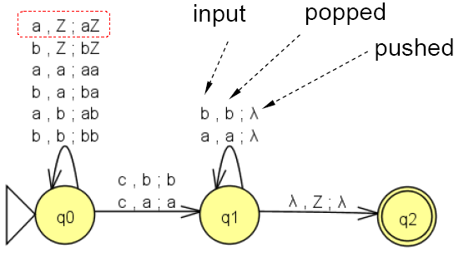
7.3: Deterministic PDA (4)
The language of (strings over {a, b} of even length and spelled the same forwards and backwards) = {ww^{R} | w ∈{a, b}*} is CFL and accepted by a non-deterministic PDA M
ε, Z;Z
ε, a;a
ε, b;b

Slide 6
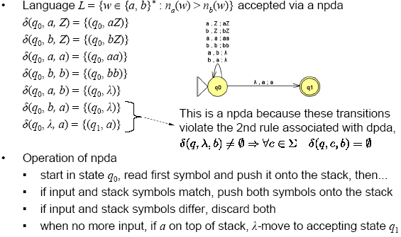
7.3: Deterministic PDA (5)

Slide 7
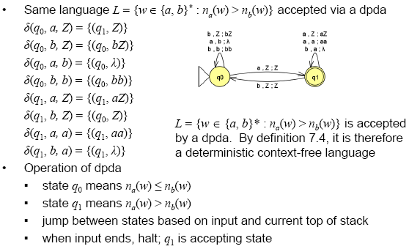
7.3: Deterministic PDA (6)

Slide 8
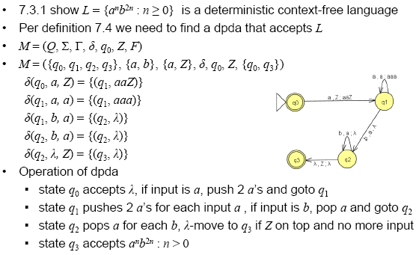
7.3: Deterministic PDA (7)

Slide 9
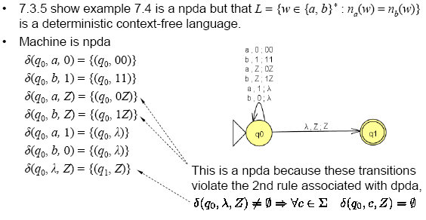
7.3: Deterministic PDA (8)

Slide 10
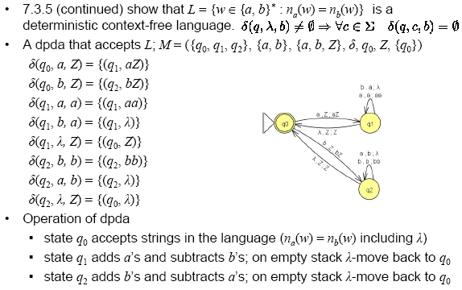
7.3: Deterministic PDA (9)

